Slide 1

JEDI Bootcamp Presentation
Presented By- Namrata Khurana
Trainer – Amit Kr. Balyan
Notes:
Hi Everyone,
Good Morning
Before we start with the presentation today, I would like to share a small recital.
We have been a part of Publicis Sapient for almost 3months now, and there is this fact that everyone of us would agree upon.
We all started as fresh graduates, underwent 5weeks or so of rigorous training followed by what…5 weeks now of a Hands On project, and what has transpired in these days is a fact that we all are really proud of. A transformation from someone who could code, to someone who can not only code, but add value to everything he does.
So have we succeeded at becoming a Product engineer?
Hi, I am Rajat, a small part of our big team here.
I am here with my colleagues Aman and Chinmay and we are here to give you a walkthrough of our Transformation, our Journey and the project we have been working for sometime now.

Slide 2
Framework for 3 Weeks
Introduction to Unix/Linux
Introduction to Git and Github
SDLC and OOAD with UML
Core Java Programming
MySQL Fundamentals
Dropwizard
Project

Slide 3
Framework for 3 Weeks
Everyday discussion
Doubt Clearance
Understanding Technologies
Progress Report
Error Debugging
Assignments
Tests

Slide 4
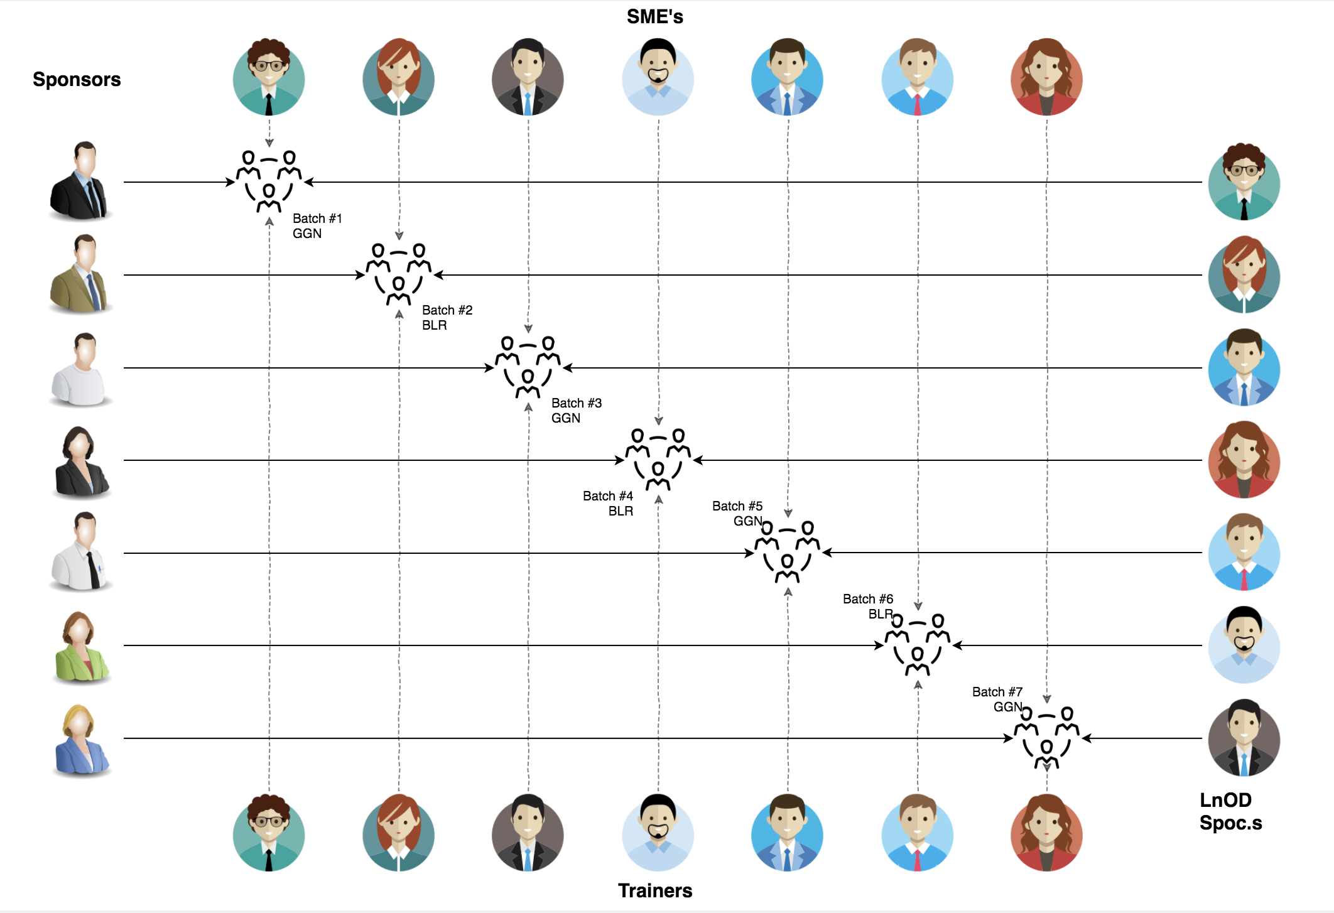
Stakeholders
Sponsors
Flipkart
SME’s
Trainer
HR
L&D Team
Trainers
Trainers
Assess

Slide 5
Our next starts
NOW
Notes:
Time – 1 min
Swati

Slide 6
3 WEEKS OF TRAINING + PROJECT DEMO
16 DAYS
128 HOURS
7,680 MINUTES
460,800 SECONDS
LIMITLESS KNOWLEDGE

Slide 7

Agenda
01
Our Journey
02
Our Team
03
Project Goals
04
Engineering Practices
05
Tech Stack
06
Development
07
Challenges & Learnings
08
Demo
09
Questions
Notes:
Time – 1 min

Slide 8

Our Journey
Notes:
Time - 2 mins

Slide 9
Demo
Mindset
Process
5
Project Deployment with Jersey and Dropwizard
Tools
4
Java Project Development with database and logger
Comprehend
3
Decide the Technologies JAVA/REST/Dropwizard/Git
2
Design Patterns and Principles using UML
1
Understanding Project Development tools like linux/git

Slide 10

Our Team
Notes:
Time – 2 mins

Slide 11


Amit Kr. Balyan
Namrata Khurana

Slide 12

Project Goals
Notes:
Time – 3 mins

Slide 13




Problem Statement
To create a Student Management System using full stack development tools and technologies, which allows students to register for courses and view report. Professors will be able to access the system to sign up to teach courses as well as record grades. The college will keep the existing course catalog database where all course information is maintained. The system will allow students to select course offerings for the coming semester. Course offerings will have a maximum of ten For each semester, there is a period of time that students can change their schedule. Students must be able to access the system during this time to add or drop courses. Once the registration process is completed for a student, the registration system sends information to the billing system so the student can be billed for the semester.
1
2
Quality
Security
3
4
Interactivity
Speed
Notes:
User satisfaction and brand value

Slide 14

Engineering Practices (Design Patterns and Principles-UML)
Notes:
Time – 5 mins

Slide 15
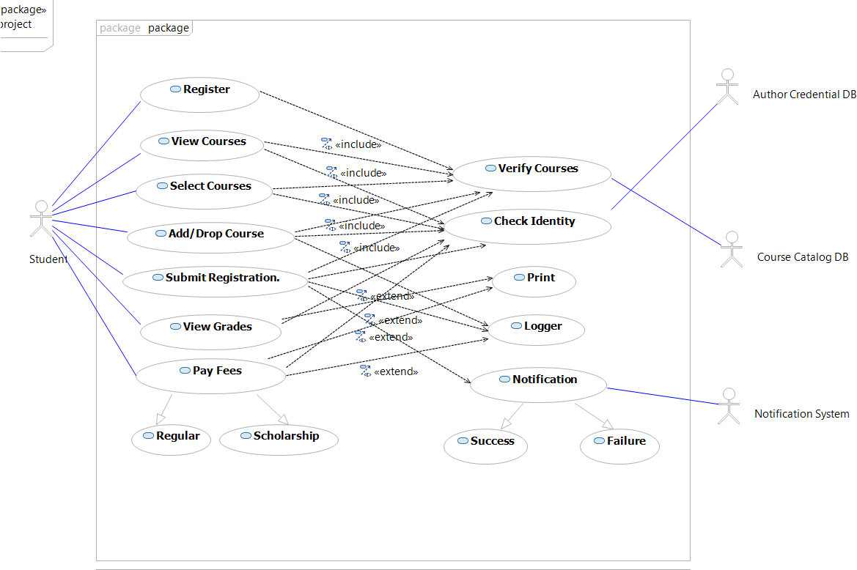
Use Case
Notes:
User satisfaction and brand value

Slide 16
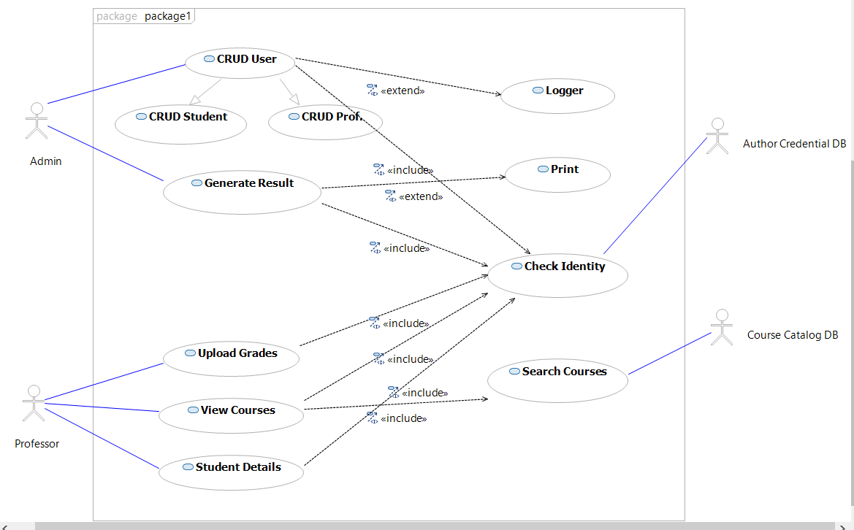
Use Case
Notes:
User satisfaction and brand value

Slide 17
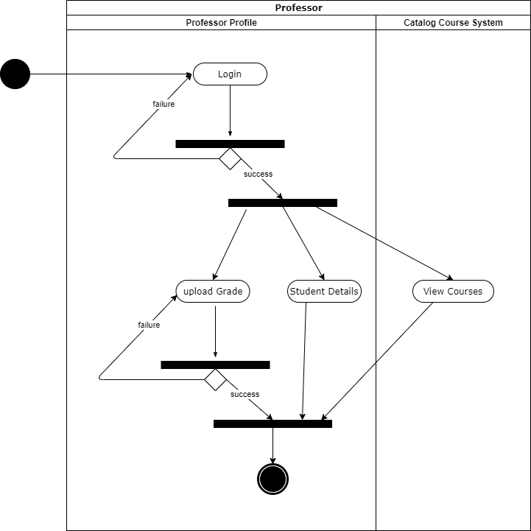
Activity Diagram
Notes:
User satisfaction and brand value

Slide 18
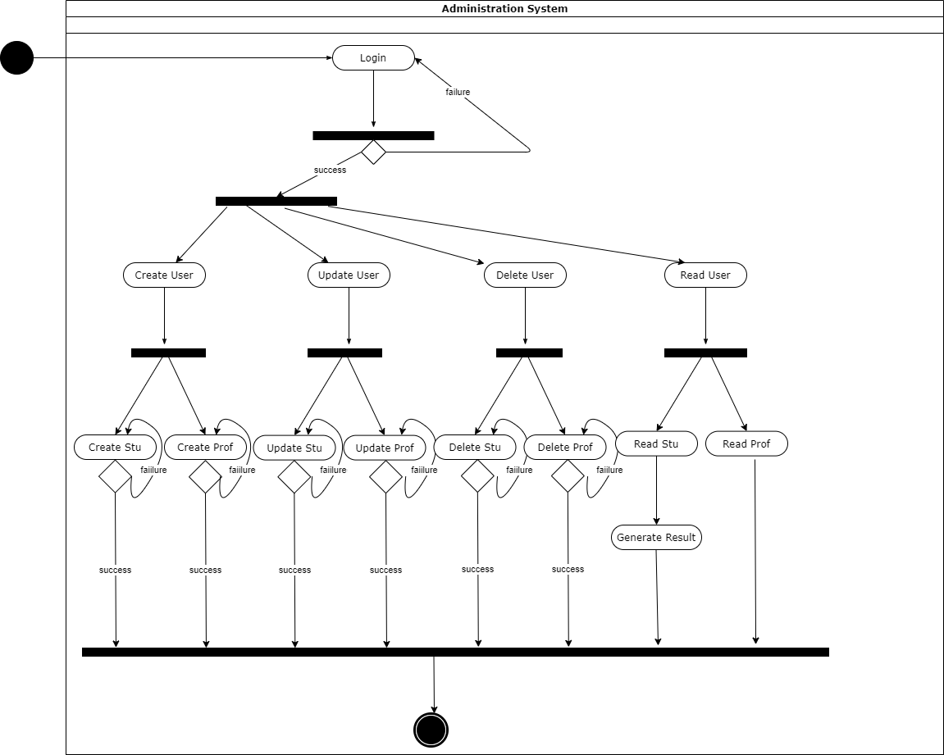
Activity Diagram
Notes:
User satisfaction and brand value

Slide 19
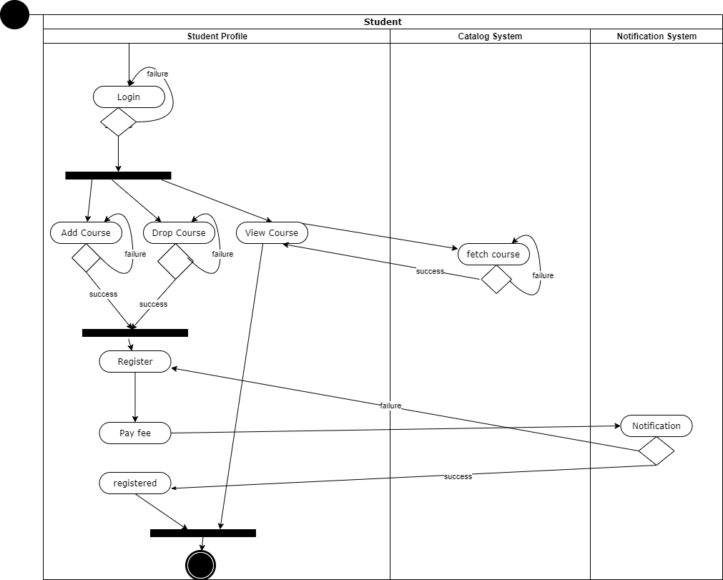
Activity Diagram
Notes:
User satisfaction and brand value

Slide 20
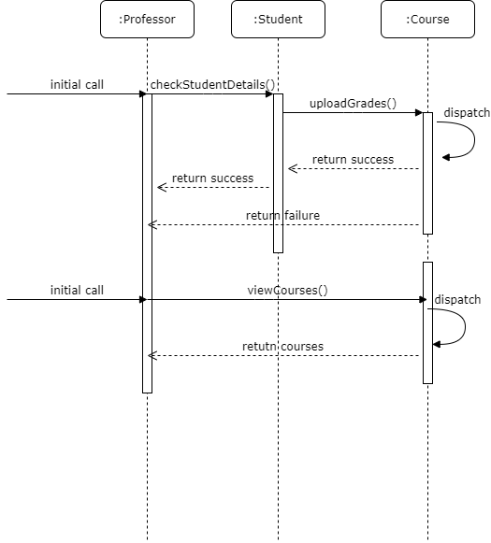
Sequence Diagram
Notes:
User satisfaction and brand value

Slide 21
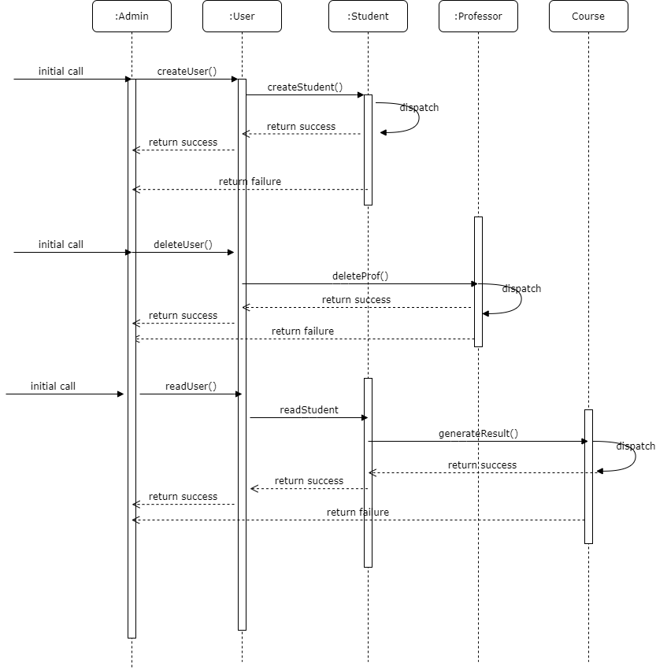
Sequence Diagram
Notes:
User satisfaction and brand value

Slide 22
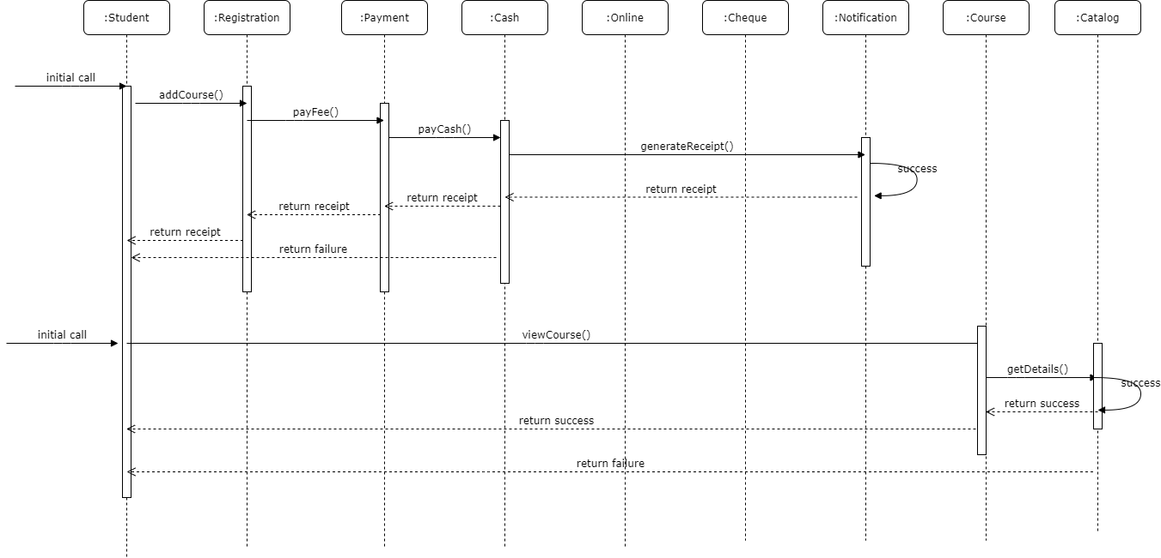
Sequence Diagram
Notes:
User satisfaction and brand value

Slide 23
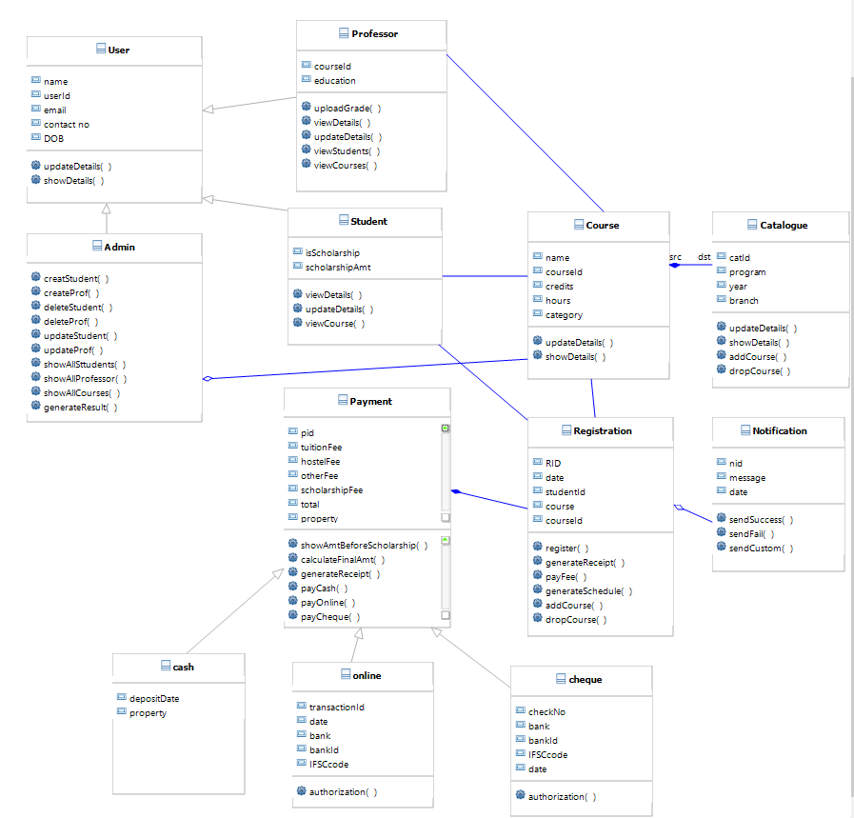
Class Diagram
Notes:
User satisfaction and brand value

Slide 24
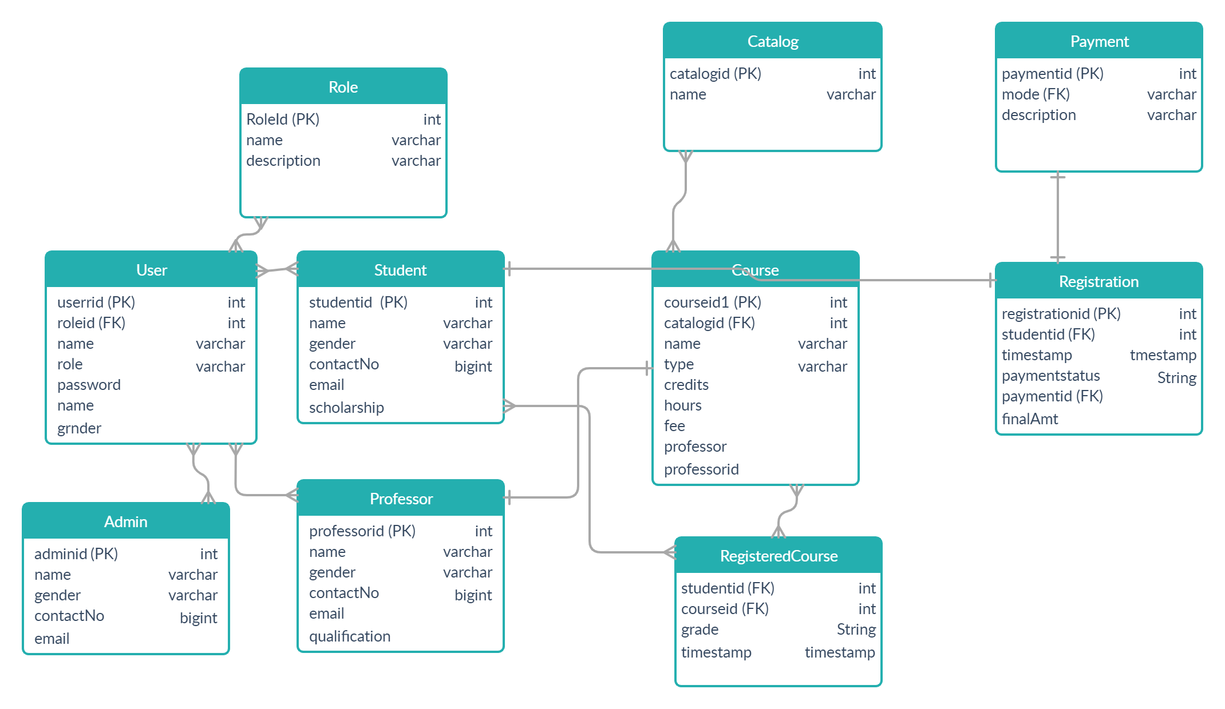
Database Schema
Notes:
User satisfaction and brand value

Slide 25

Tech Stack
Notes:
Time – 2 mins

Slide 26







Backend
Infra
Tools
Core Language
Build Automation Tool
Version Control
Web Service
Data
Graphical DB Mgmt.
Application Server
SQL Database
Notes:
Time – 1 min

Slide 27

Development
Notes:
Time – 1 min

Slide 28
Development Phases
UML Modelling to understand the dynamic and static flow of system
Designing of Database Schema
Student Management Core Java Project
Student Management Rest Jersey Project
Student Management Dropwizard Project
Version Control with git and Documentation

Slide 29

Challenges and LeArnings
Notes:
Time – 2 mins

Slide 30
Challenges
Setting up Environment is harder than writing code!
Representing logic in an understandable manner
Braving against the unknown errors and exceptions

Slide 31
Learnings
Writing Clean, Concise and Readable Code
Importance of different phases of SDLC
Transformation from writing code to adding value to code
Resolving Errors and Debugging
Design Principles and Patterns of development
Importance of Version Control and Documentation

Slide 32

Demo
Notes:
Time –
Architecture – 5 mins
NFR Dashboard – 3 mins
Demo – 10 mins
1. Show the Responsiveness and Wave tool first

Slide 33

Questions
Notes:
Time - ?

Slide 34
Thank you
Notes:
Time – After this show the testimonial video. 1 min

